Slide 1


A Complete Society Management System
Notes:
NESTIN simplify the complexities of RWA operations and helps build a better communication system between the residents and RWA

Slide 2
ABOUT NESTIN
Nestin helps manage Housing Society by connecting and involving residents.
Administrator can perform management task using web interface while user can perform task like authorizing guests, raising tickets, share opinion or discuss on a subject through web interface or Android interface while on the go.
Notes:
Nestin .. A society management system

Slide 3
OUR VISION
1
3
Our vision is to provide ease of living, better security, and better communications to the societies.
Our Vision is to carter the emerging need for a better management solution of these gated communities.
2
4
The gated communities are small cities within walls consisting of a large number of people residing in more than hundred of apartments
We pave the way for these communities to work in a well-integrated environment and help improve RWA operations
Notes:
Our vision

Slide 4
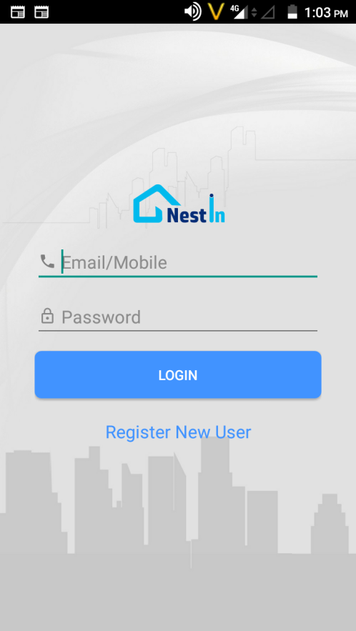
NESTIN the right solution..
Easy To Understand Interface
No complex or fancy features,
simple and easy for everyone to use
Solid Backend Infrastructure
Our application is built with the latest technologies, with all data security measures
Continuous Evolving
we continuously aim to improve and evolve as per user feedback and usage.
Data updates in runtime
All the information, instructions, notification and data/reports are available and get updated in real time.
Excellent Customer Support
Dedicated customer support from user activation to application complain.
Customization
We Provide customized add on's as per your request
Notes:
Why Choose Us?

Slide 5





for all your society
management requirements
• Complaint Management
• Vendor Directory
• Visitor Management
• SMS Notification
• Rent in & Rent Out • Sale & Purchase
• Notice Board
• Forum & Discussions
Notes:
Nestin a complete solution to all your problems…. Making everyday life easy and efficient in gated communities

Slide 6
Owner/ Tenant records
The system maintains the data history of all user type which can access the application.
This include Flats, it’s owners, Tenants and Employees.
Even for Tenants movement in and out of society
Notes:
Now manage large complex tenant's data easily, disseminate important notice to all the residents in one go! Forget worrying about maintaining a register for bill payments and dues. NESTIN!! empowering your society digitally.

Slide 7
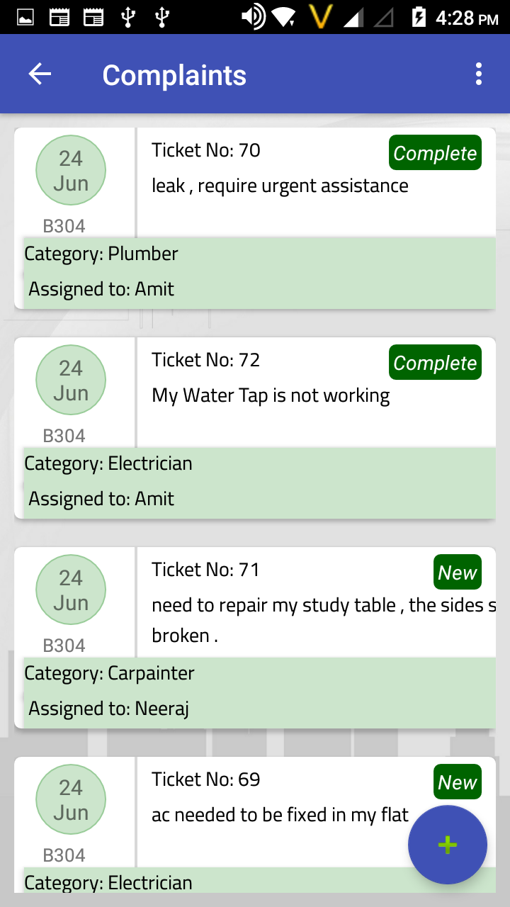
Complaint
Residents can raise complaint using Web and mobile interface anytime anywhere,
Complaint will be automatically be assigned to concerned person with out waiting for someone to assign it.
This assignment will not only look for concerned person, but will also look at his engagement.
Notes:
Now know what's happening in your society with a click, get update on vendors and rate services, auto assign complaints to the concerned personnel, pay and maintain bills easily.

Slide 8
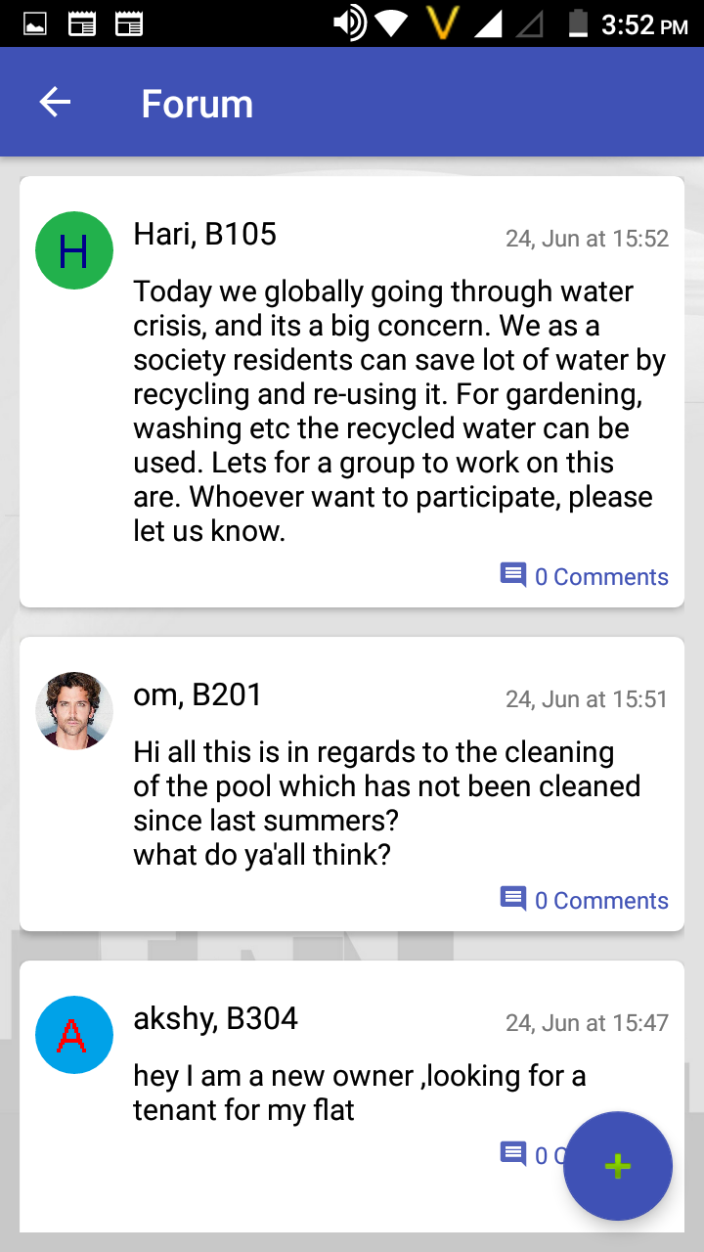
Forum & Discussion
Residents can use this internal discussion platforms for sharing views and information.
Residents need discussion and brain storming for future decision making or may be taking initiative like garbage handling, plantation, future events or any other social topic.
Notes:
All the latest news, topic of discussion and share your opinion with everyone in the society..

Slide 9
Ride Share
Ride with people you trust
YES
YES
Riding Noida today. Anyone Interested to pool with me?
YES
.

Slide 10
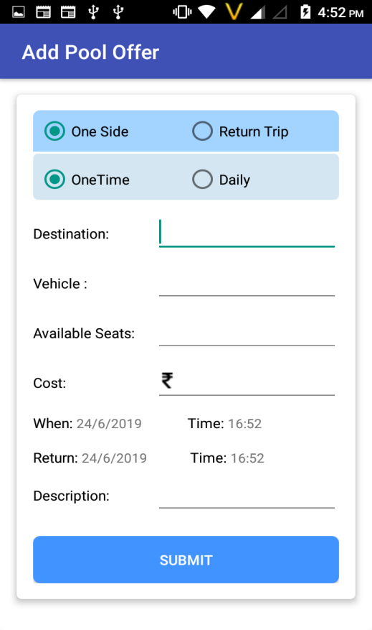
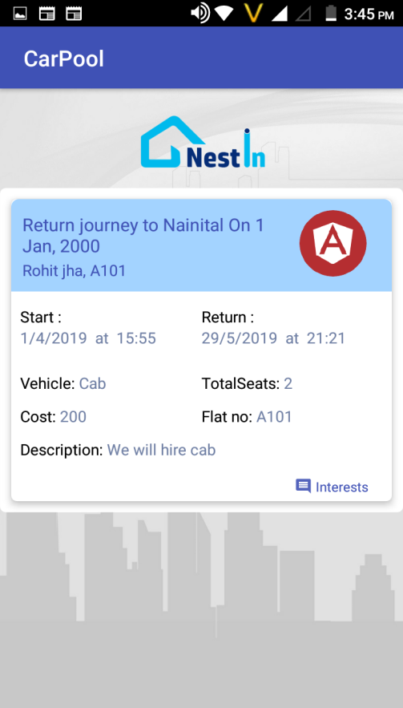
Ride Share it’s a simple process
Now ride with people you trust from within your society
Call the person who show interest and book your pool. Happy Ride share
Its simple Add your pool offer
Select destination & negotiate on the price and submit

Slide 11
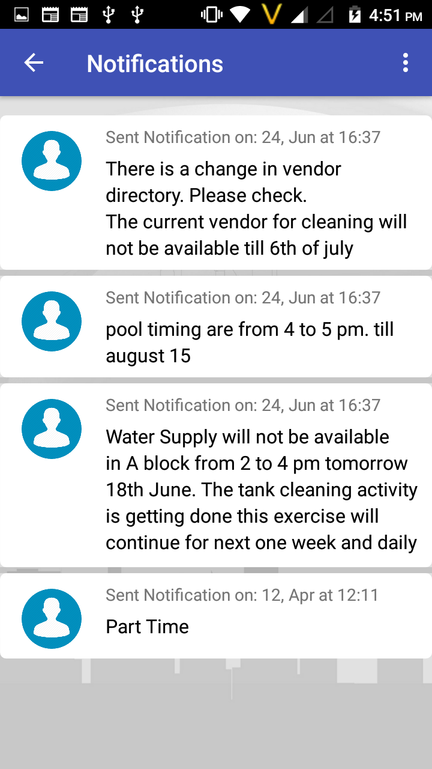
Notification
There are many official message RWA wants to communicate to residents.
Residents with their busy life find it difficult to follow the RWA Communication.
This function help residents to see the communications anytime from anywhere.
Any official communication from RWA office bearer will reach timely to all residents
Notes:
Get all the notification about important events and notice via call and sms on your smartphones

Slide 12
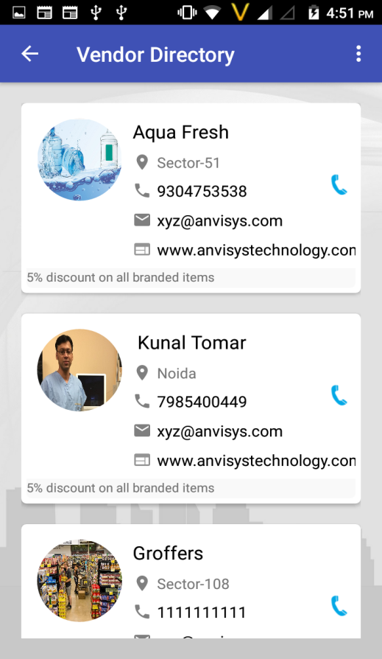
Vendors
There are many vendors providing services to your society be it Water suppliers, Newspaper Vendor, Milk Vendor etc.
With this function residents need not to run around asking contact information from guard, neighbours or searching visiting cards.
Open application, go to vendor list and you have it even the recently added vendor.
.
Notes:
Now upgrade your society with NESTIN. An app for all your day to day problems, from vendor management, advanced security system to share your ride feature and much more all in just one app.

Slide 13
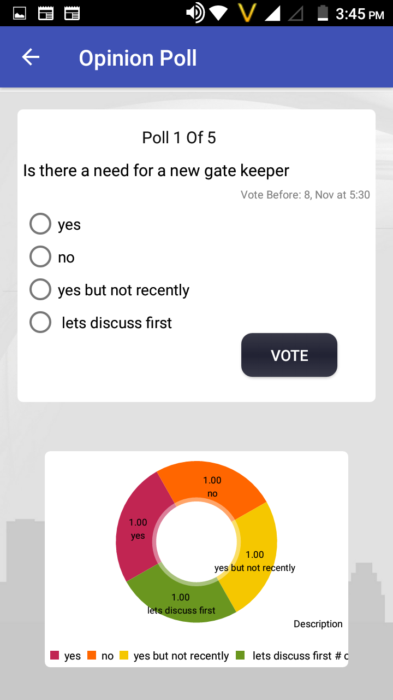
Opinion
Different people have different opinion in a society, and to take a collaborative decision
RWA need to collect everyone’s view. RWA can conduct a poll in your society before taking decision on any topic you want.
.
I VOTE FOR IT
NO
YES
YES
Notes:
Vote and share your opinions via Opinion poll feature in Nestin app. Because your opinion matter’s

Slide 14
Security
****
Old Process
New Process
• Visitor / Guard calls from gate.
VS
• Enter Visitor data with Time in Application- Mobile or Web
• Make entry in Register
• Visitor gets on OTP on sms
• You takes call on Intercom
• If misses, Guest provide mobile
number to call
• At Guard tells OTP to Guard
• Guard verify OTP and allow check in
Notes:
Nestin replaces the old vary security process of your gated communities into a better efficient and safer system.

Slide 15



Benefits for the stakeholders
RWA’s
Residents
Vendors
Cost & Time Effective
Large data easily manage
Ride share
Better services
Discussion forum
Vendor’s variety
Manage all tenants records
Opinions polls
Notes:
The content needs to be changed kindly look into the slide as it’s content is from shobit.

Slide 16
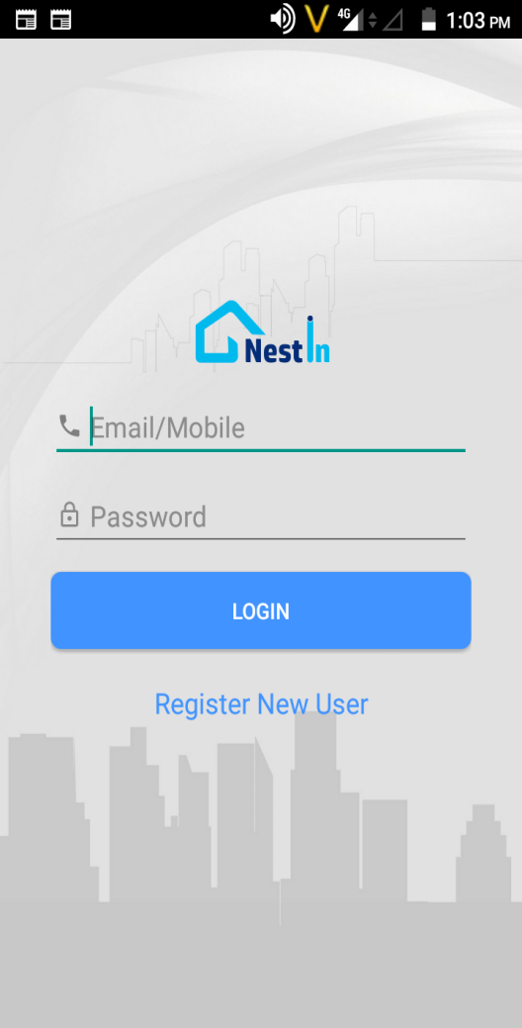
Product Features
Society Management Other Features
•Services/Complaints
• Rent in & Rent Out,
• Sale & Purchase
• Security/Guest Entry
• Notices and Information
• Bills and Payments
• Advertisements
• Discussion / Forum
• Vendor Registration
• Vendor Directory
• Opinion Polls

Slide 17


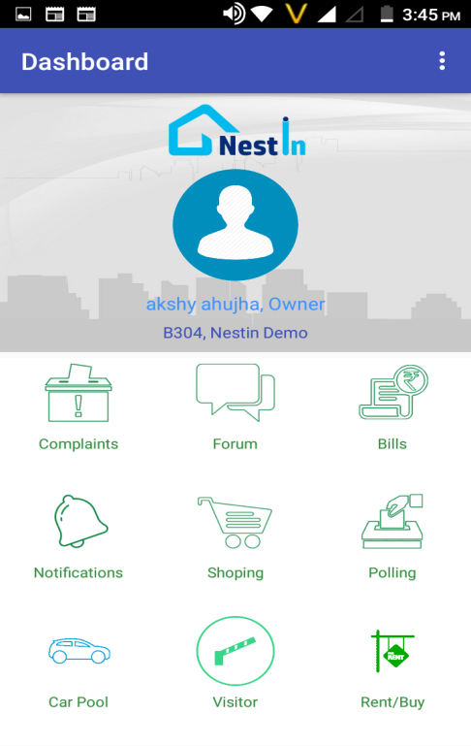
Why Societies should opt for a Society Management System?
Vendor Management.
Bills and Payments Management.
Notices and Information.
Discussion Forum.
Opinion Polls to vote over important decisions.
Security for society /Guest Entry.
Rent in & Rent Out.
Sale & Purchase.

Slide 18
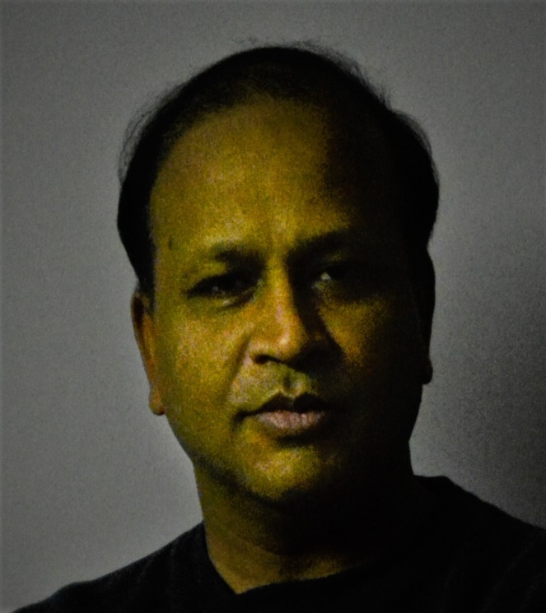
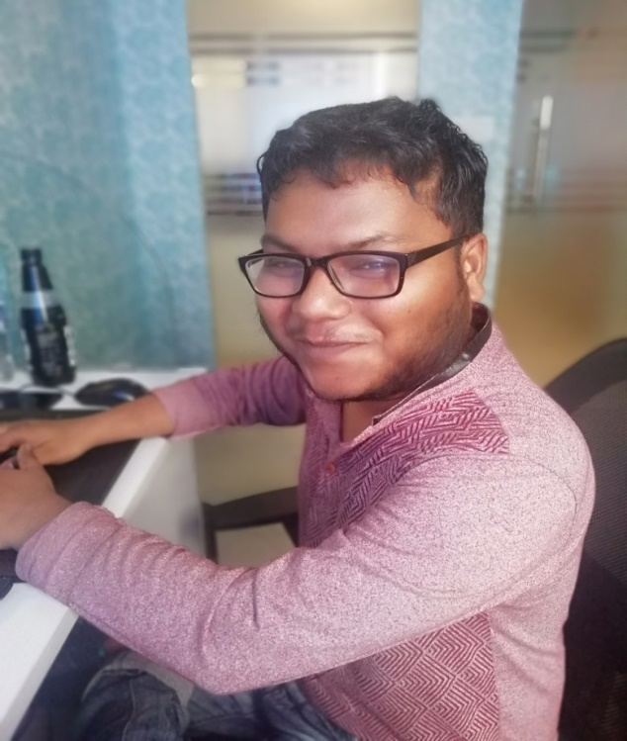

Amit Bansal
Sagar Srivastava
Shivang Bhatnagar
DI R EC T O R M.Tech.- IIT Roorkee
A N D O I D DEVE L O P E R
W E B DE V E LO P E R
B.E. Computer Science
B.E. Computer Science
18 Years Experience
3 Year Experience
2 Year Experience

Slide 19

Peaceful Homes

